Slide 1
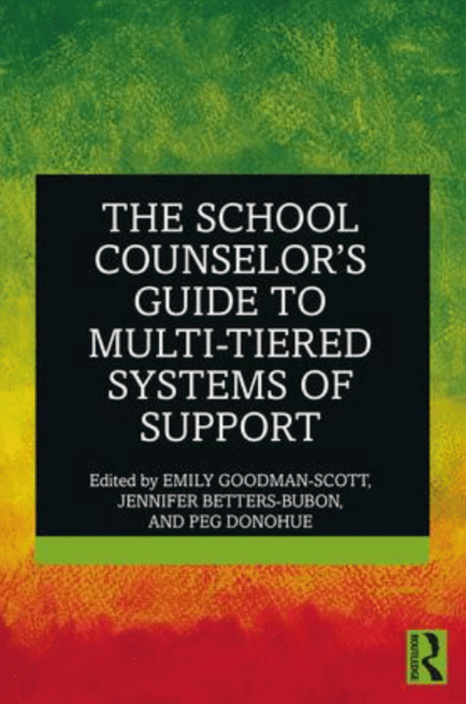
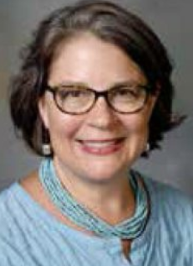
Using Prevention Science: Aligning Your School Counseling
Program with Multi-Tiered Systems of Support (MTSS)
Friday November 15, 2019
9 am to 12 pm
Central Connecticut State University
Vance Hall, Room 105
Description:
This 3-hour workshop provides an overview of how to best align your Comprehensive School Counseling Program (CSCPs) with Multiple Tiered Systems of Support (MTSS) with a focus on infusing prevention science. Based on the text book, The School Counselor’s Guide to Multiple-Tiered Systems of Support (Routledge, 2019), this training explores both strong theoretical/research underpinnings and practical applications to support the implementation of effective and culturally responsive services. Participants will engage in hands-on activities, self/program assessments and action planning sessions to enhance their ability to meet the academic, social, emotional and college/career development needs of their students.
Presenter: Dr. Peg Donohue, Assistant Professor, CCSU. Before joining the CCSU faculty, Dr. Donohue spent 16 years working as a school counselor in both Connecticut and California. Her primary research interests include: fostering social and emotional learning, aligning school counselor preparation with multiple tiered systems of support (MTSS), and universal screening for mental health concerns in schools.
To register: please go to https://csca.wildapricot.org/ by November 10.

